Slide 1
Introduction to Time-series forecasting
Brought to you by: MLDA | Ho Chi | Hui Xiang

Slide 2

Wooclap
wooclap.com/MLDATSF

Slide 3


Ho Chi
Hui Xiang
CS Year 1
linkedin.com/in/nghochi/
REP Year 1
linkedin.com/in/hui-xiang/

Slide 4

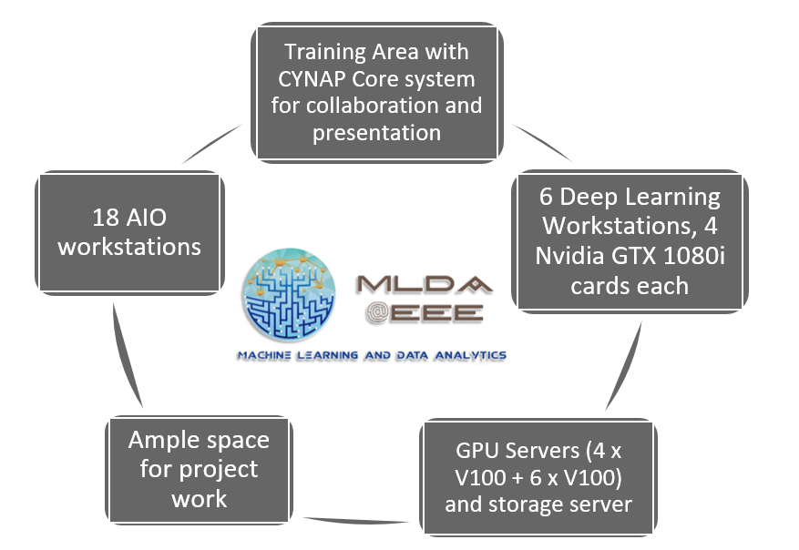
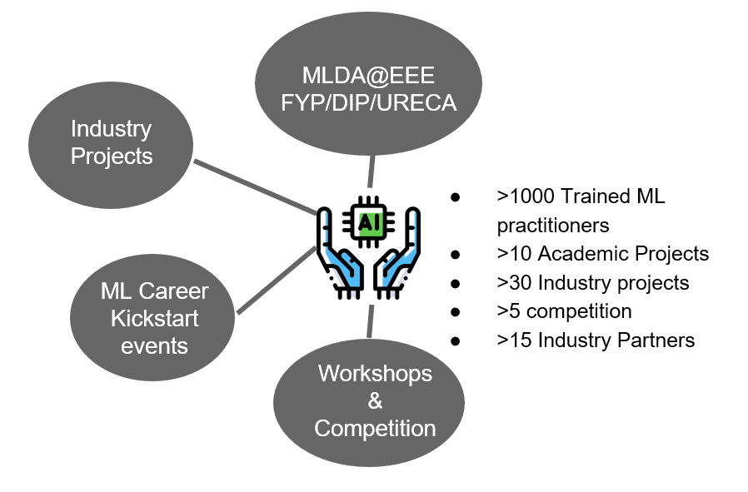

Slide 5



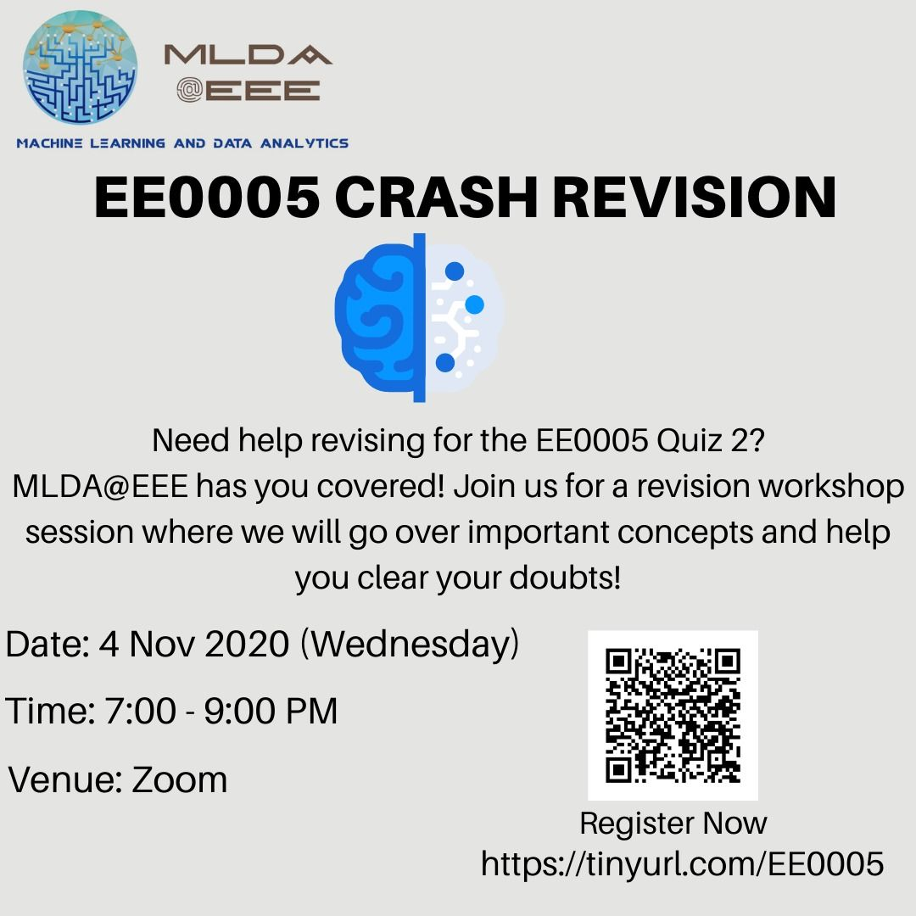










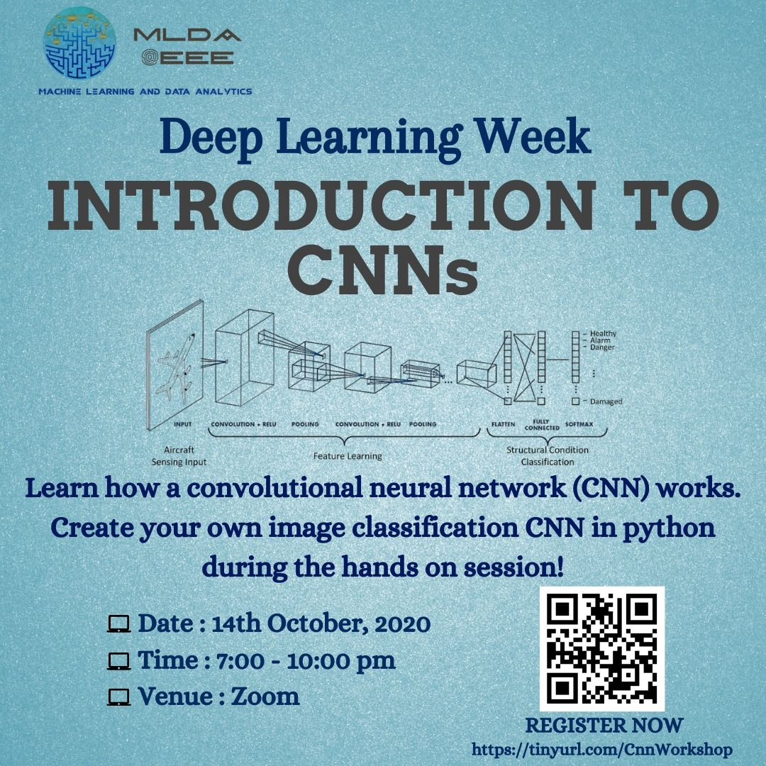

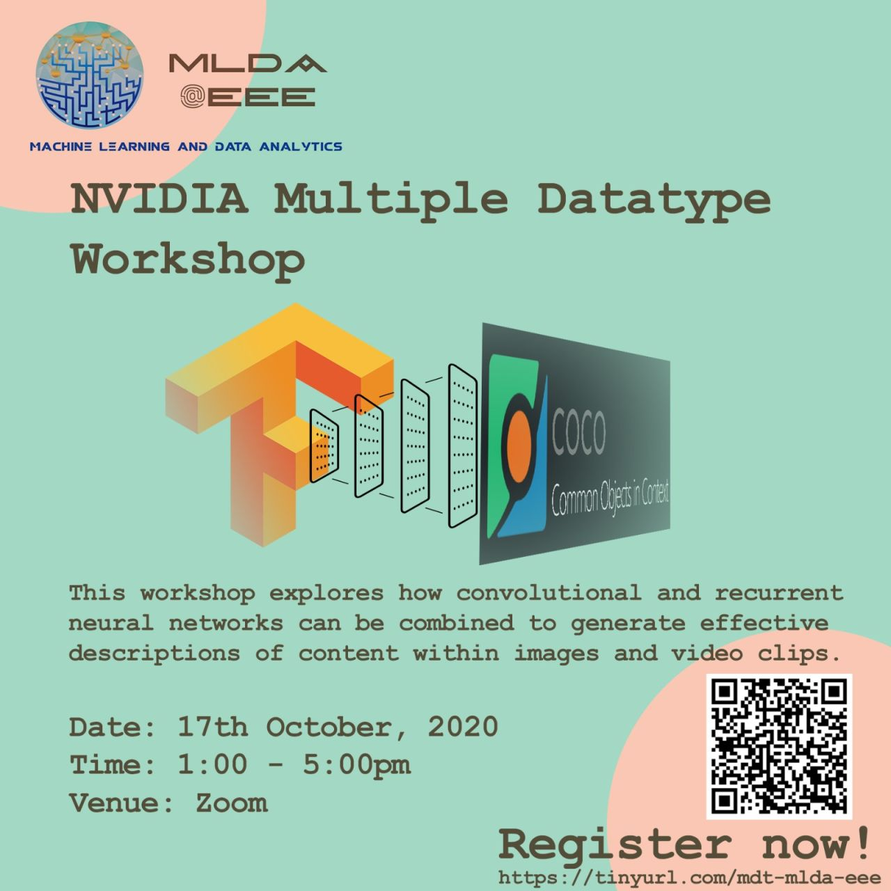


What we do
LEARN
APPLY
CONNECT
Listen to our workshops
Do projects that belong to yourselves
Hear from the industry
Notes:
MLDA@EEE is a student-led club, that aims to provide a platform to empower NTU students to pursue the application of Machine Learning, Data analytics and artificial intelligence. We do so by providing them with a place to learn, apply and connect with our industry partners and the academia

Slide 6
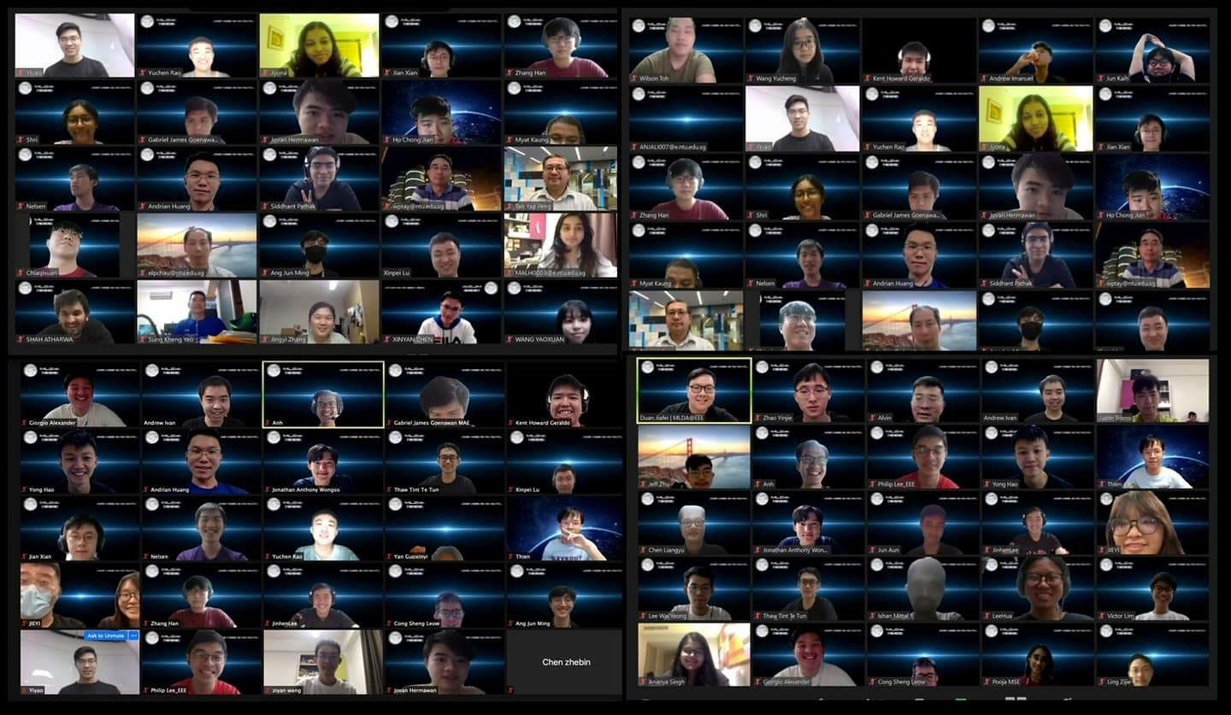
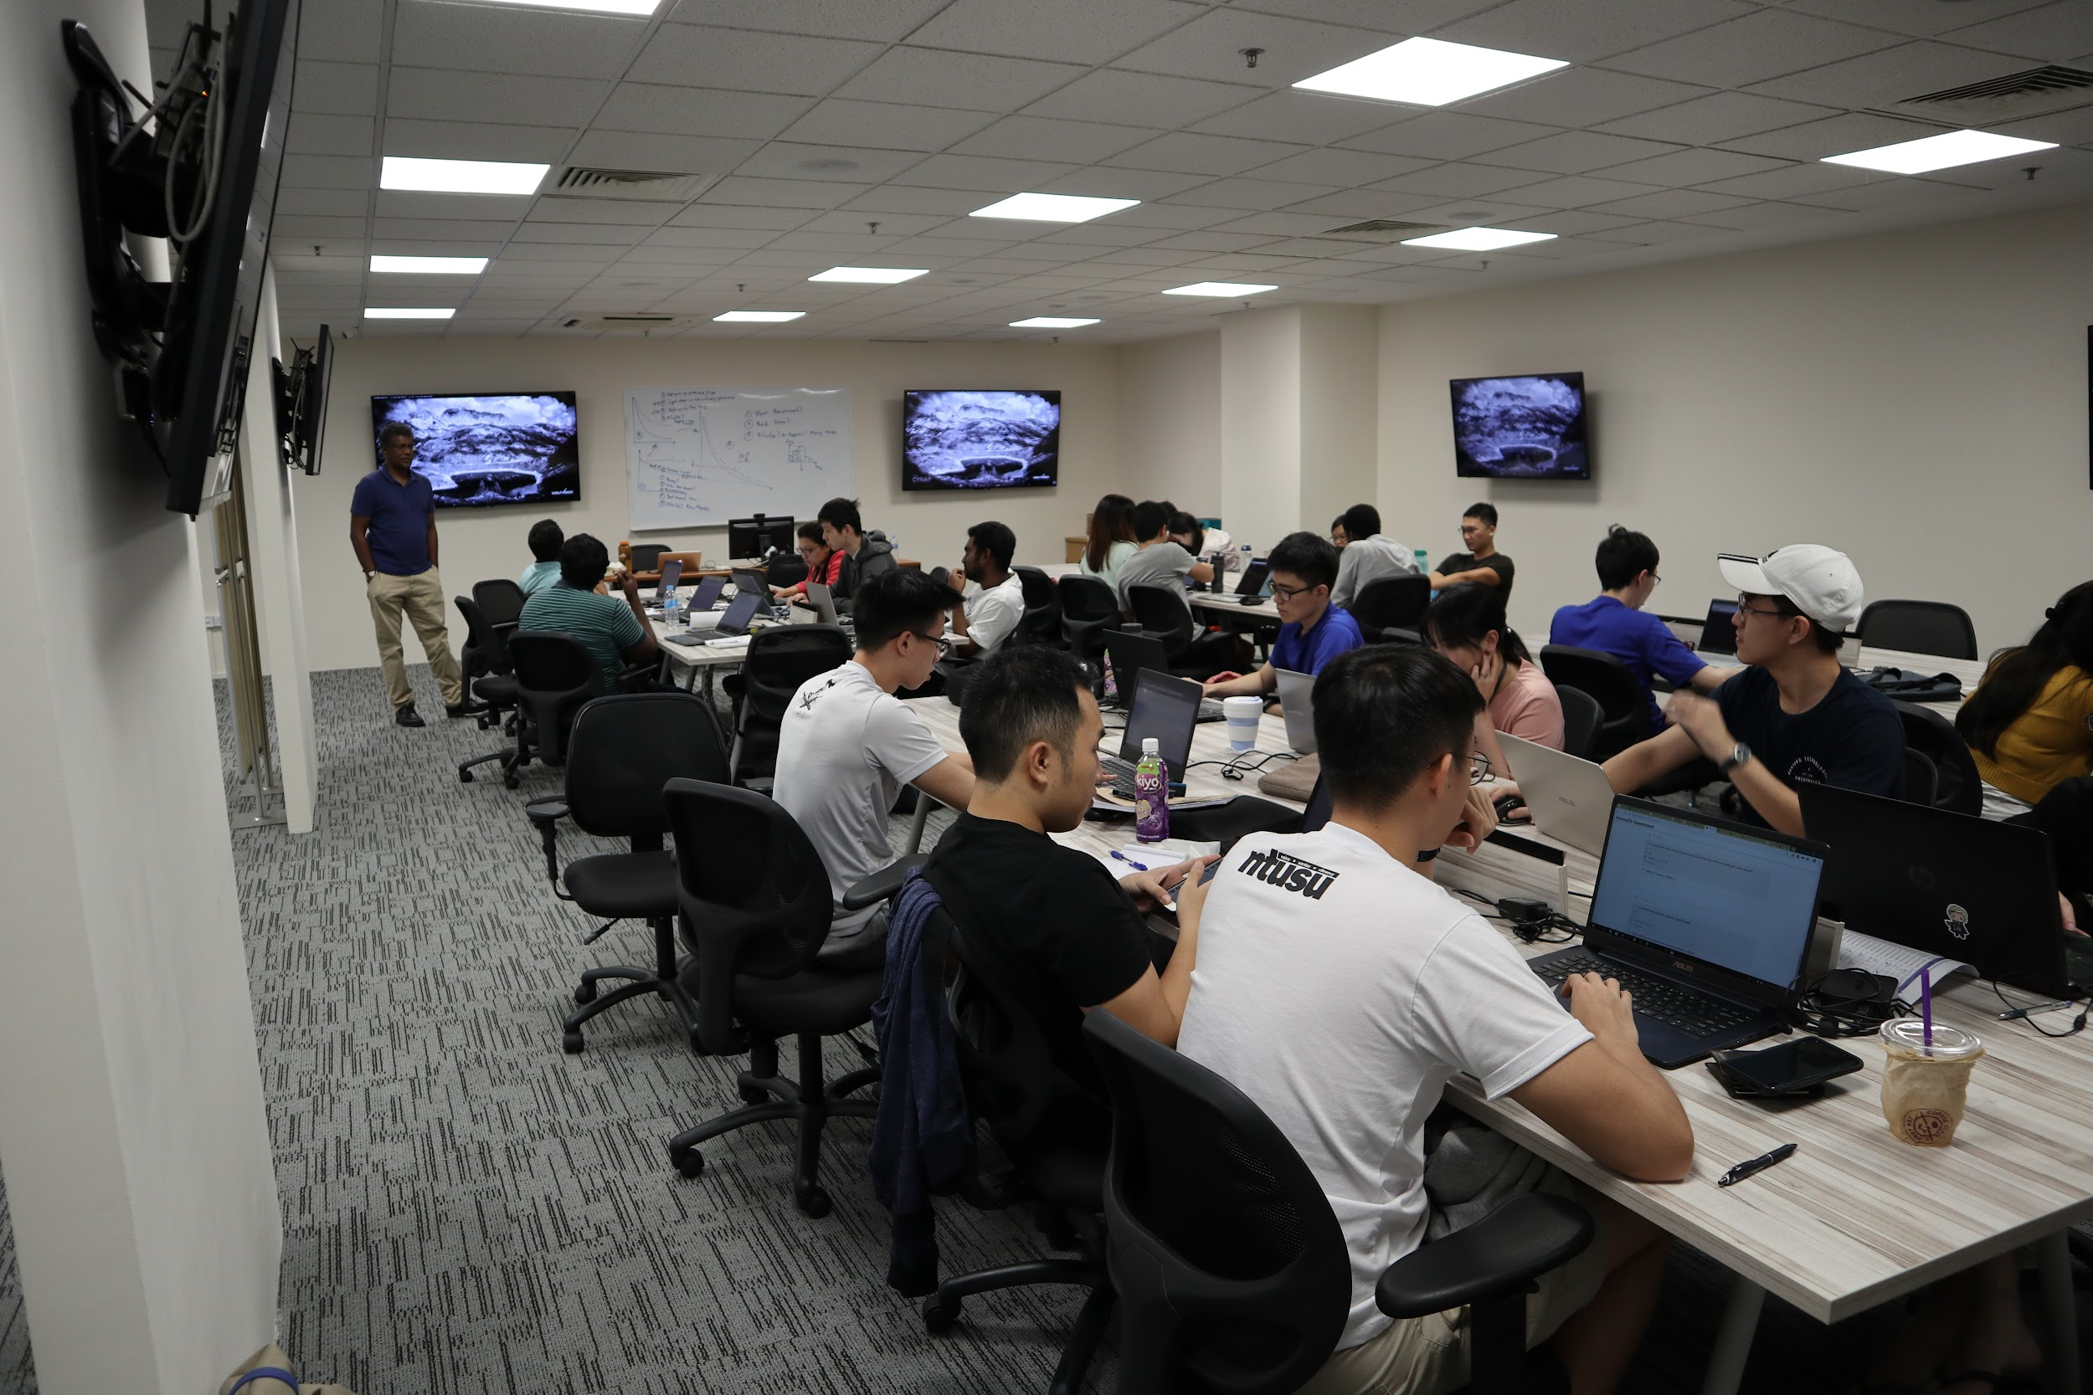

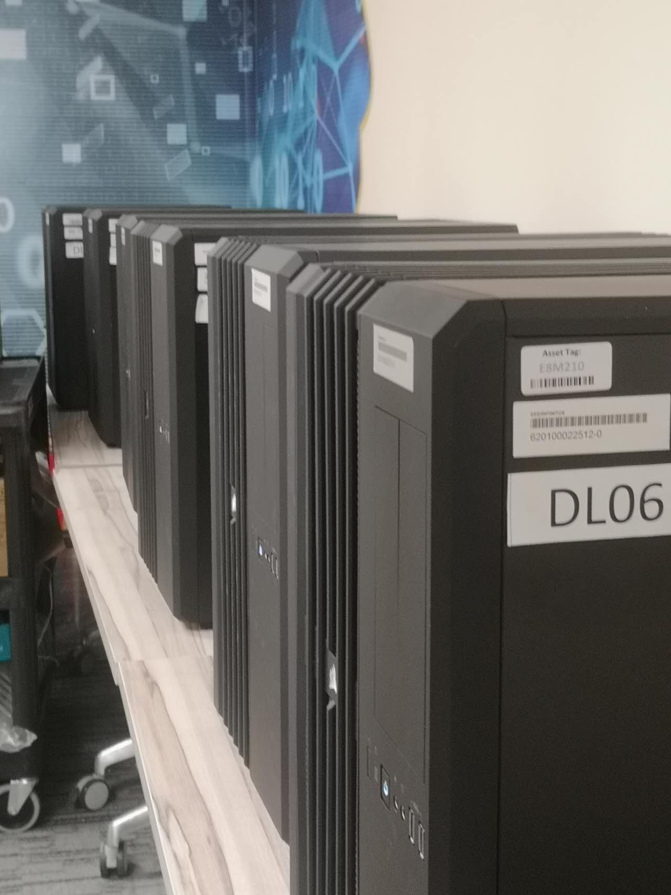














What we have
Like-minded Students in NTU
Project Partner / Research Partner
Friends in similar path of personal development
Academic facilities
GPUs
RTX 3090, GTX 2080 Ti, GTX 1080 Ti
Equipments
Robot Master *2
3D printer *1
Drones *1
…
Industrial Connections
Sponsors & Partners
Notes:
MLDA@EEE is a student-led club, that aims to provide a platform to empower NTU students to pursue the application of Machine Learning, Data analytics and artificial intelligence. We do so by providing them with a place to learn, apply and connect with our industry partners and the academia

Slide 7






Follow us to stay tuned!
https://www.ntu.edu.sg/eee/student-life/mlda
Machine Learning and Data Analytics at EEE NTU
Machine Learning and Data Analytics Lab at NTU EEE
@mlda_at_eee_ntu
MLDA-NTU

Slide 8




Agenda
Time Series Forecasting
Non-ML methods
Some knowledge to get you started!
Time Series Forecasting w/o ML?? Wow!
Machine Learning Methods
Wrap-up
Time Series Forecasting w/ ML?? Wow!
Knowledge consolidation and wrap-up

Slide 9
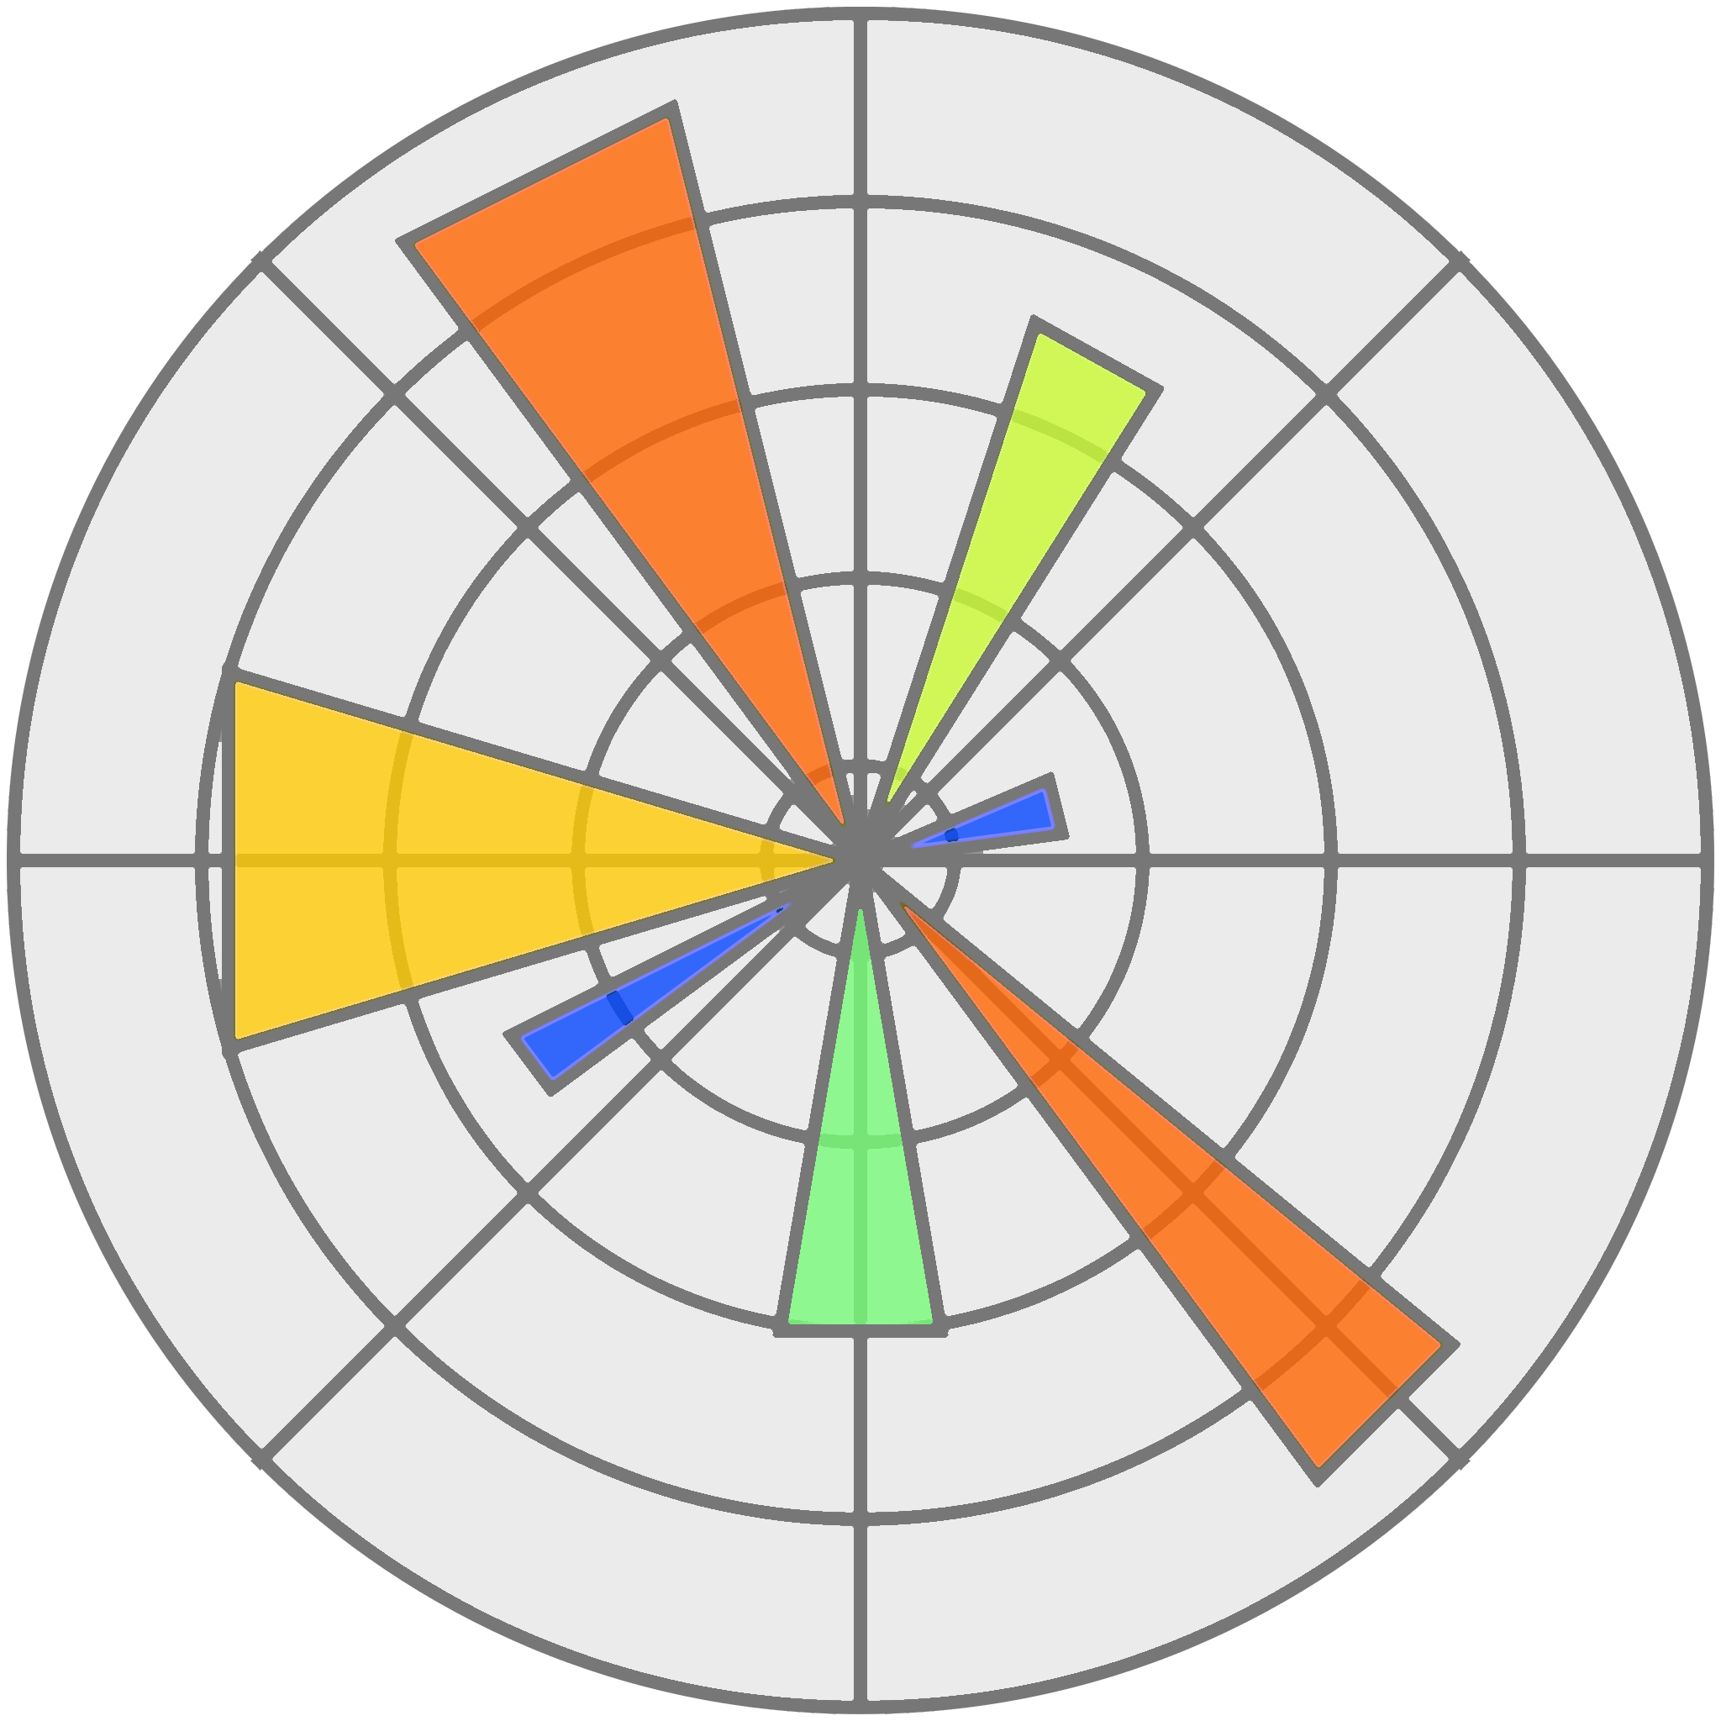


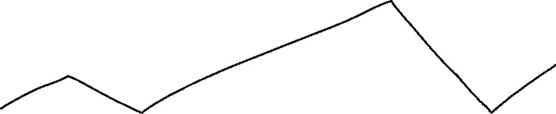
Agenda
Prerequisite
x
Anything that I might need to already know?
Visualisation Libraries
Python
Machine Learning Basics

Slide 10
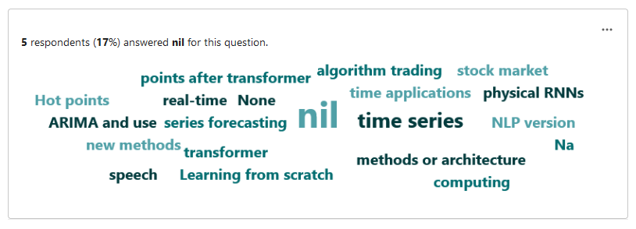
Agenda

Slide 11
Agenda
Time Series Forecasting
Non-ML methods
Some knowledge to get you started!
Time Series Forecasting w/o ML?? Wow!
Machine Learning Methods
Wrap-up
Time Series Forecasting w/ ML?? Wow!
Knowledge consolidation and wrap-up

Slide 12
Agenda
Time Series Forecasting
Non-ML methods
Some knowledge to get you started!
Time Series Forecasting w/o ML?? Wow!
Machine Learning Methods
Wrap-up
Time Series Forecasting w/ ML?? Wow!
Knowledge consolidation and wrap-up

Slide 13
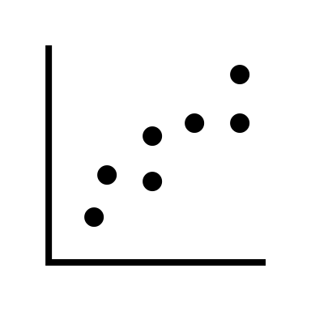
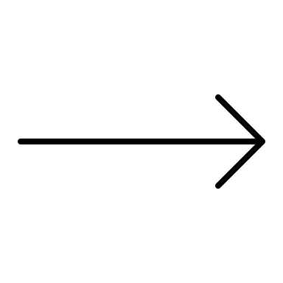
x | y
1 | 1
1.2 | 2
2.2 | 1.8
2.2 | 2.8
3.2 | 3
4.2 | 3
4.2 | 4.1
Use trends in past data to predict future data

Slide 14
x | y
1 | 1
1.2 | 2
2.2 | 1.8
2.2 | 2.8
3.2 | 3
4.2 | 3
4.2 | 4.1
Linear Regression

Slide 15
Weather
100
75
50
25
0
Temperature of Singapore
*Not Accurate

Slide 16
Health
100
75
50
25
0
Covid 19 Cases (MY)
Covid 19 Cases (SG)
*Not accurate
*Definitely not accurate

Slide 17
Stock Markets
100
Generic Stock #1
Generic Company #1
75
Generic Stock #2
50
Generic Company #2
25
Generic Stock #3
Generic Company #3
0

Slide 18
Traditional Methods (Math & Statistics)
100
75
50
25
0
Week 01
Week 02
Week 03

Slide 19
Machine Learning Methods

Slide 20
Agenda
Time Series Forecasting
Non-ML methods
Some knowledge to get you started!
Time Series Forecasting w/o ML?? Wow!
Machine Learning Methods
Wrap-up
Time Series Forecasting w/ ML?? Wow!
Knowledge consolidation and wrap-up

Slide 21
Agenda
Time Series Forecasting
Non-ML methods
Some knowledge to get you started!
Time Series Forecasting w/o ML?? Wow!
Machine Learning Methods
Wrap-up
Time Series Forecasting w/ ML?? Wow!
Knowledge consolidation and wrap-up

Slide 22


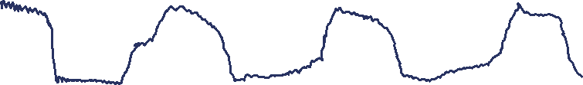
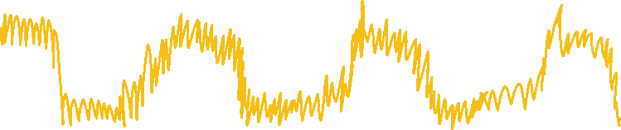
Autoregression
2015
2016
2017
2018
2019
2020

Slide 23
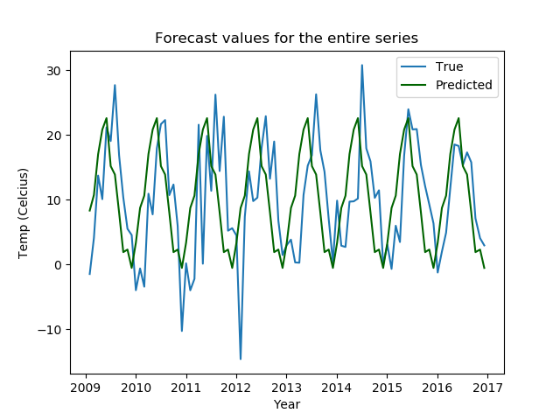
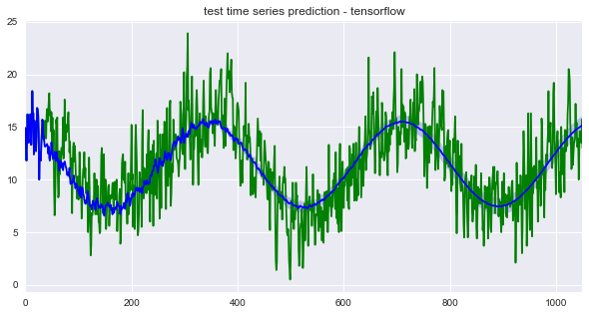
Autoregression
2015
2016
2017
2018
2019
2020

Slide 24


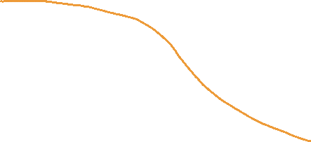
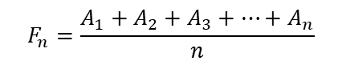
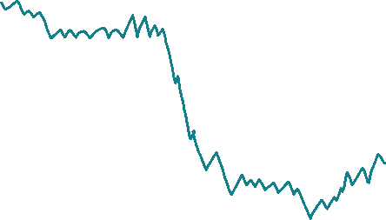
Simple Moving Average
Average
True
$$F_{n}=\frac{A_{1}+A_{2}+A_{3}+⋯+A_{n}}{n}$$

Slide 25
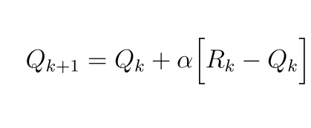


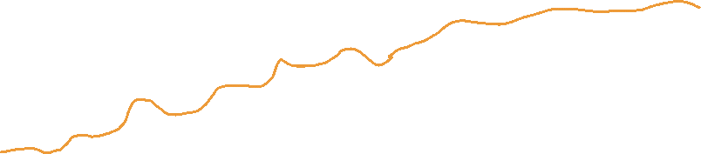
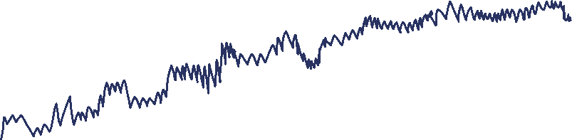
Exponential Smoothing
100
75
50
25
0
True Line
Smoothened Line
Less smooth than Simple Moving Average, but tends to give a better estimate
$$F_{t+1}=F_{t}+α(A_{t}−F_{t})$$
Hands-On!

Slide 26

Exponential Smoothing
100
75
50
25
0
True Line
Smoothened Line
Less smooth than Simple Moving Average, but tends to give a better estimate
$$F_{t+1}=F_{t}+α(A_{t}−F_{t})$$
Hands-On!
https://tinyurl.com/yhvmmwvb

Slide 27
Exponential Smoothing
100
75
50
25
0
True Line
Smoothened Line
Less smooth than Simple Moving Average, but tends to give a better estimate
$$F_{t+1}=F_{t}+α(A_{t}−F_{t})$$
Hands-On!
https://tinyurl.com/yhvmmwvb

Slide 28
100
75
50
25
0
15mins break! If you have any questions so far, feel free to submit them on the wooclap!​
E
B
K
R
A

Slide 29
Agenda
Time Series Forecasting
Non-ML methods
Some knowledge to get you started!
Time Series Forecasting w/o ML?? Wow!
Machine Learning Methods
Wrap-up
Time Series Forecasting w/ ML?? Wow!
Knowledge consolidation and wrap-up

Slide 30
Agenda
Time Series Forecasting
Non-ML methods
Some knowledge to get you started!
Time Series Forecasting w/o ML?? Wow!
Machine Learning Methods
Wrap-up
Time Series Forecasting w/ ML?? Wow!
Knowledge consolidation and wrap-up

Slide 31


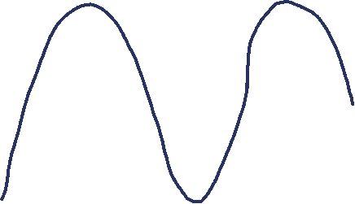
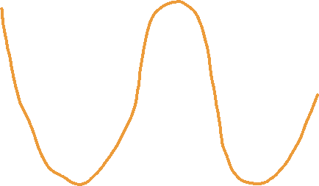
Where do you think the next point is?
Yellow Line
Where is the next point? 1. A 2. B 3. C
Blue Line
Where is the next point? 1. A 2. B 3. C
A
B
C

Slide 32
What do you think the next word is?
Today the weather is gorgeous, and I see a beautiful blue…

Slide 33
What do you think the next word is?
Today the weather is gorgeous, and I see a beautiful blue sky!

Slide 34




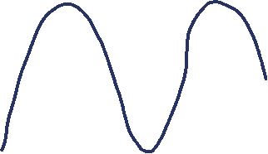

A
Today the weather is gorgeous, and I see a beautiful blue sky!
B
C

Slide 35

Time-Series Forecasting w/ Neural Networks
h_{t}
h_{t}
h_{t}
x
+
x
+
tanh
1-
tanh
x
x
x
x
σ
σ
tanh
σ
σ
σ
tanh
RNN
LSTM
GRU
x_{t}
x_{t}
x_{t}

Slide 36
Time-Series Forecasting w/ Neural Networks
Overview of RNNs
h_{t}
h_{t}
h_{t}
x
+
x
+
tanh
1-
tanh
x
x
x
x
σ
σ
tanh
σ
σ
σ
tanh
RNN
LSTM
GRU
x_{t}
x_{t}
x_{t}

Slide 37
Overview of RNNs
h_{t}
tanh
x_{t}

Slide 38

Overview of RNNs
h_{t}
x_{t}

Slide 39
Overview of RNNs
h_{t}
h_{t}
h_{t}
h_{t}
h_{t}
x_{t}
x_{t}
x_{t}
x_{t}
x_{t}
Today the weather is gorgeous, and I see a beautiful blue sky!

Slide 40
Overview of RNNs
h_{t}
h_{t}
h_{t}
h_{t}
h_{t}
x_{t}
x_{t}
x_{t}
x_{t}
x_{t}
… I see a beautiful blue …

Slide 41
Overview of RNNs
h_{t}
h_{t}
h_{t}
h_{t}
h_{t}
x_{t}
x_{t}
x_{t}
x_{t}
x_{t}
blue
…
see
beautiful
…
I
a

Slide 42
Overview of RNNs
h_{t}
h_{t}
h_{t}
h_{t}
h_{t}
x_{t}
x_{t}
x_{t}
x_{t}
x_{t}
I
see
a
beautiful
blue

Slide 43
Overview of RNNs
h_{t}
h_{t}
h_{t}
h_{t}
h_{t}
x_{t}
x_{t}
x_{t}
x_{t}
x_{t}
I
see
a
beautiful
blue

Slide 44
Overview of RNNs
h_{t}
h_{t}
h_{t}
h_{t}
h_{t}
x_{t}
x_{t}
x_{t}
x_{t}
x_{t}
I
see
a
beautiful
blue

Slide 45
Overview of RNNs
h_{t}
h_{t}
h_{t}
h_{t}
h_{t}
x_{t}
x_{t}
x_{t}
x_{t}
x_{t}
I
see
a
beautiful
blue

Slide 46
Overview of RNNs
h_{t}
h_{t}
h_{t}
h_{t}
h_{t}
x_{t}
x_{t}
x_{t}
x_{t}
x_{t}
I
see
a
beautiful
blue

Slide 47
Overview of RNNs
h_{t}
h_{t}
h_{t}
h_{t}
h_{t}
x_{t}
x_{t}
x_{t}
x_{t}
x_{t}
I
see
a
beautiful
blue

Slide 48
Time-Series Forecasting w/ Neural Networks
Overview of RNNs
h_{t}
h_{t}
h_{t}
x_{t}
tanh
Input at time t
tanh
x
+
x
+
tanh
1-
tanh
x
x
x
x
h_{t}
σ
σ
tanh
σ
σ
σ
tanh
Output at time t
Vector Concatenation
RNN
LSTM
GRU
x_{t}
x_{t}
x_{t}

Slide 49
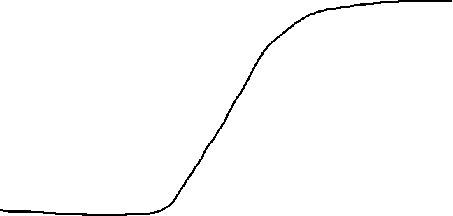
Time-Series Forecasting w/ Neural Networks
Overview of RNNs
h_{t}
h_{t}
h_{t}
x_{t}
tanh
Input at time t
tanh
x
+
x
+
tanh
1-
tanh
x
x
x
x
h_{t}
σ
σ
tanh
σ
σ
σ
tanh
Output at time t
Vector Concatenation
RNN
LSTM
GRU
x_{t}
x_{t}
x_{t}

Slide 50
Overview of RNNs
h_{t}
x_{t}
tanh
Input at time t
tanh
tanh
h_{t}
Output at time t
Vector Concatenation
RNN
x_{t}

Slide 51
Overview of RNNs
h_{t}
h_{t}
h_{t}
h_{t}
h_{t}
x_{t}
x_{t}
x_{t}
x_{t}
x_{t}
I
see
a
beautiful
blue

Slide 52
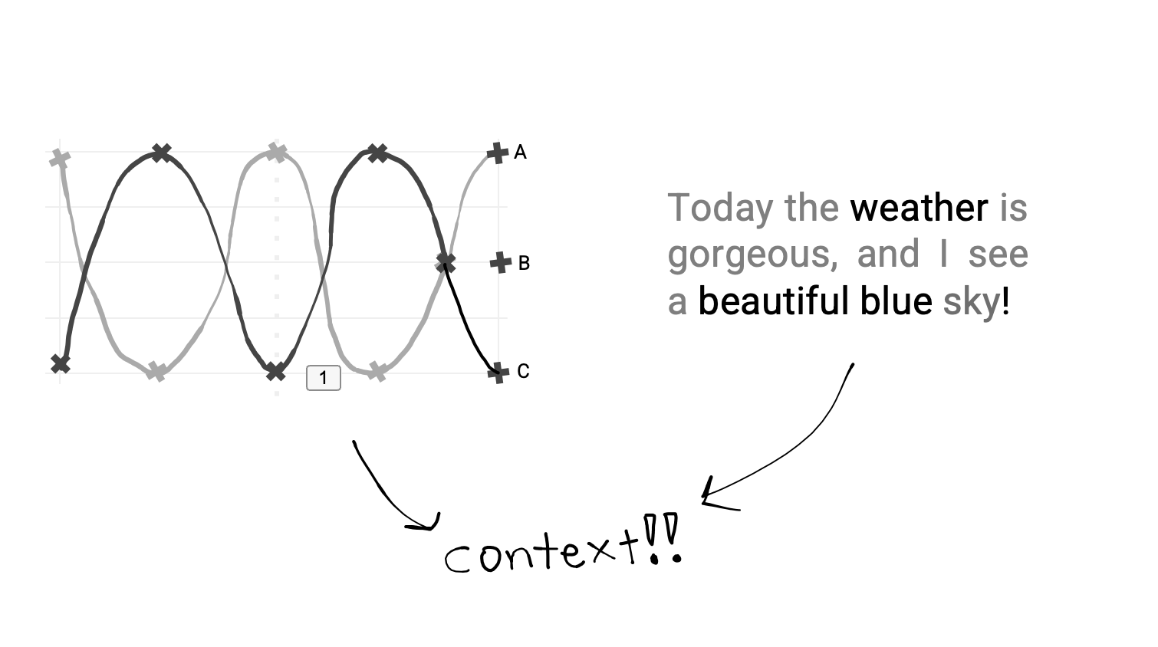
Overview of RNNs
h_{t}
h_{t}
h_{t}
h_{t}
h_{t}
x_{t}
x_{t}
x_{t}
x_{t}
x_{t}
I
see
a
beautiful
blue

Slide 53
Overview of LSTMs
σ
h_{t}
sigmoid
x_{t}
tanh
Input at time t
x
+
tanh
tanh
x
x
h_{t}
σ
σ
tanh
σ
Output at time t
Vector Concatenation
x_{t}
x
Pointwise
Multiplication
+
Pointwise
Addition

Slide 54
Overview of LSTMs
σ
h_{t}
sigmoid
x_{t}
tanh
Input at time t
x
+
tanh
tanh
x
x
h_{t}
σ
σ
tanh
σ
Output at time t
Vector Concatenation
x_{t}
x
Pointwise
Multiplication
+
Pointwise
Addition

Slide 55
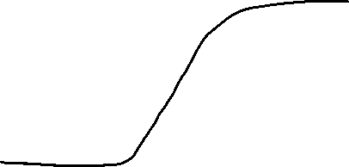
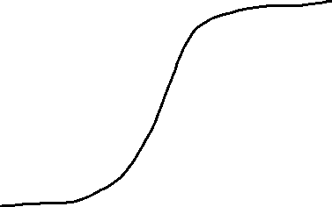
Overview of LSTMs
σ
h_{t}
sigmoid
x_{t}
tanh
Input at time t
x
+
tanh
tanh
x
x
h_{t}
σ
σ
tanh
σ
Output at time t
Vector Concatenation
x_{t}
x
Pointwise
Multiplication
+
Pointwise
Addition

Slide 56
Overview of LSTMs
σ
h_{t}
sigmoid
x_{t}
tanh
Input at time t
x
+
tanh
tanh
x
x
h_{t}
σ
σ
tanh
σ
Output at time t
Vector Concatenation
x_{t}
x
Pointwise
Multiplication
+
Pointwise
Addition

Slide 57
Overview of LSTMs
σ
h_{t}
sigmoid
x_{t}
tanh
Input at time t
x
+
tanh
tanh
x
x
h_{t}
σ
σ
tanh
σ
Output at time t
Vector Concatenation
x_{t}
x
Pointwise
Multiplication
+
Pointwise
Addition

Slide 58
Overview of LSTMs
σ
h_{t}
sigmoid
x_{t}
tanh
Input at time t
x
+
tanh
tanh
x
x
h_{t}
σ
σ
tanh
σ
Output at time t
Vector Concatenation
x_{t}
x
Pointwise
Multiplication
+
Pointwise
Addition

Slide 59
Overview of LSTMs
σ
h_{t}
sigmoid
x_{t}
tanh
Input at time t
x
+
tanh
tanh
x
x
h_{t}
σ
σ
tanh
σ
Output at time t
Vector Concatenation
x_{t}
x
Pointwise
Multiplication
+
Pointwise
Addition

Slide 60
Overview of LSTMs
σ
h_{t}
sigmoid
x_{t}
tanh
Input at time t
x
+
tanh
tanh
x
x
h_{t}
σ
σ
tanh
σ
Output at time t
Vector Concatenation
x_{t}
x
Pointwise
Multiplication
+
Pointwise
Addition

Slide 61
Overview of GRUs
σ
h_{t}
sigmoid
x_{t}
tanh
Input at time t
x
+
tanh
x
1-
x
h_{t}
σ
σ
tanh
Output at time t
Vector Concatenation
x_{t}
x
Pointwise
Multiplication
+
Pointwise
Addition

Slide 62
Time-Series Forecasting w/ Neural Networks
Hands-On!
h_{t}
h_{t}
h_{t}
x
+
x
+
tanh
1-
tanh
x
x
x
x
σ
σ
tanh
σ
σ
σ
tanh
RNN
LSTM
GRU
x_{t}
x_{t}
x_{t}
https://tinyurl.com/yhvmmwvb

Slide 63
Time-Series Forecasting w/ Neural Networks
Hands-On!
h_{t}
h_{t}
h_{t}
x
+
x
+
tanh
1-
tanh
x
x
x
x
σ
σ
tanh
σ
σ
σ
tanh
RNN
LSTM
GRU
x_{t}
x_{t}
x_{t}
https://tinyurl.com/yhvmmwvb

Slide 64
Agenda
Time Series Forecasting
Non-ML methods
Some knowledge to get you started!
Time Series Forecasting w/o ML?? Wow!
Machine Learning Methods
Wrap-up
Time Series Forecasting w/ ML?? Wow!
Knowledge consolidation and wrap-up

Slide 65
Agenda
Time Series Forecasting
Non-ML methods
Some knowledge to get you started!
Time Series Forecasting w/o ML?? Wow!
Machine Learning Methods
Wrap-up
Time Series Forecasting w/ ML?? Wow!
Knowledge consolidation and wrap-up

Slide 66

Wrap-Up
Post Workshop Survey!
tinyurl.com/4heupsf9

Slide 67
Wrap-Up
Post Workshop Survey!
tinyurl.com/4heupsf9
Thank you for your participation in this workshop and hope you have enjoyed it. ​
Please fill in the workshop’s feedback form for new and improved workshops in the future!​
All rights reserved to their respective owners and this workshop is solely for learning purposes. ​
Should you have any further questions or would like to voice out any errors in the materials, do feel free to reach out via chay0022@e.ntu.edu.sg / c210142@e.ntu.edu.sg.​

Slide 68
Thank you! Any final questions?
Post Workshop Survey!
tinyurl.com/4heupsf9

Slide 69
Exponential Smoothing
100
75
50
25
0
Mercury
Mars
Jupiter
Mercury is the closest planet to the Sun
Despite being red, Mars is actually a cold place
Jupiter is a gas giant and is the biggest of them all

Slide 70
Line Chart Infographics
100
Mercury
Mercury is the closest planet to the Sun and is really hot
75
Mars
50
Despite being red, Mars is actually a cold place
25
Jupiter
Jupiter is a gas giant and it’s the biggest of them all
0

Slide 71
Line Chart Infographics
2015
2016
2017
2018
2019
2020
Mercury
Jupiter
Saturn
Mercury is the closest planet to the Sun
Jupiter is the biggest planet of them all
Saturn is the ringed one and a gas giant

Slide 72
Line Chart Infographics
Mercury is the closest planet to the Sun and is really hot
Despite being red, Mars is actually a cold place
Jupiter is a gas giant and it’s the biggest of them all
Mercury
Venus
Mars

Slide 73
Line Chart Infographics
100
Mercury
Mercury is the closest planet to the Sun and it’s really hot
75
Mars
50
Despite being red, Mars is actually a cold place
25
Jupiter
Jupiter is a gas giant and it’s the biggest of them all
0

Slide 74
Line Chart Infographics
!
Mercury
Mercury is the closest planet to the Sun and it’s really hot
!
!
!
Jupiter
Jupiter is a gas giant and it’s the biggest of them all
Mars
Despite being red, Mars is actually a cold place
1st Period
2nd Period
3rd Period
4th Period

Slide 75
Line Chart Infographics
100
75
50
25
0
Mercury
Mercury is the closest planet to the Sun and it’s really hot

Slide 76
Line Chart Infographics
Mercury
Jupiter
Mercury is the closest planet to the Sun
Jupiter is a gas giant and the biggest of them all
Mars
Earth
Despite being red, Mars is actually a cold place
Earth is the beautiful planet we all live on

Slide 77
Line Chart Infographics
Venus
Venus has a beautiful name and is the second planet from the Sun

Slide 78
Line Chart Infographics
100
75
50
25
0
Mercury
Mars
Jupiter
Mercury is the closest planet to the Sun
Despite being red, Mars is actually a cold place
Jupiter is a gas giant and is the biggest of them all

Slide 79
Line Chart Infographics
45
Mercury
70
Mars
20
Jupiter
Mercury is the closest planet to the Sun and is really hot
Despite being red, Mars is actually a cold place
Jupiter is a gas giant and the biggest of them all

Slide 80
Line Chart Infographics
Mercury
Mercury is the closest planet to the Sun and is really hot
Mars
Despite being red, Mars is actually a cold place
1st Period
2nd Period

Slide 81
Line Chart Infographics
100
75
50
25
0
Mars
Jupiter
Despite being red, Mars is actually a cold place
Jupiter is a gas giant and the biggest of them all

Slide 82
Line Chart Infographics
100
0
Mars
Jupiter
Despite being red, Mars is actually a cold place
Jupiter is a gas giant and it’s the biggest of them all

Slide 83
Line Chart Infographics
Mercury
Mercury is the closest planet to the Sun
Jupiter
Jupiter is a gas giant and it’s the biggest of them all
Mars
Despite being red, Mars is actually a cold place
Earth
Earth is the beautiful planet we all live on
2017
2018
2019
2020
2021
2022
2023
2024

Slide 84
Line Chart Infographics
Mercury
Earth
Mercury is the closest planet to the Sun
Earth is the beautiful planet we all live on
Mars
Jupiter
Despite being red, Mars is actually a cold place
Jupiter is a gas giant and the biggest of them all

Slide 85
Line Chart Infographics
100:5
100
75:8
75:10
75
50:2
50:7
50:13
50:14
50
25:3
25:11
25
0
Mercury
Mercury is the closest planet to the Sun

Slide 86
Line Chart Infographics
Mercury
Jupiter
Mercury is the closest planet to the Sun
Jupiter is a gas giant and the biggest of them all
Mars
Earth
Despite being red, Mars is actually a cold place
Earth is the beautiful planet we all live in
2017
2018
2019
2020

Slide 87
Line Chart Infographics
100%
Jupiter is a gas giant and the biggest of them all
Jupiter
75%
Mercury is the closest planet to the Sun
Mercury
50%
Earth is the beautiful planet we all live on
Earth
25%
Despite being red, Mars is actually a cold place
Mars

Slide 88
Line Chart Infographics
100
75
50
25
0
Jupiter is a gas giant and the biggest of them all
Earth
Earth is the beautiful planet we all live on
Jupiter

Slide 89
Line Chart Infographics
100
75
50
25
0
Mercury
Mars
Jupiter
Mercury is the closest planet to the Sun
Despite being red, Mars is actually a cold place
Jupiter is a gas giant and the biggest of them all

Slide 90
Line Chart Infographics
50
45
25
15
Venus
Mercury
Venus has a beautiful name and is the second planet from the Sun
Mercury is the closest planet to the Sun and the smallest of them all

Slide 91
Line Chart Infographics
50
25
0
-25
-50
Mars
Jupiter
Despite being red, Mars is actually a cold place. It’s full of iron oxide dust
It’s a gas giant and also the biggest planet in the Solar System

Slide 92
Line Charts Infographics
100
75
50
25
0
Mercury
Mars
Mercury is the closest planet to the Sun and is really hot
Despite being red, Mars is actually a cold place

Slide 93
Line Chart Infographics
75
45
50
25
Mercury
x
Mercury is the closest planet to the Sun

Slide 94
Line Chart Infographics
50
25
0
-25
-50
Mars
Jupiter
Despite being red, Mars is actually a cold place
Jupiter is a gas giant and the biggest of them all

Slide 95
Line Chart Infographics
Jan
Feb
Mar
Apr
May
Jun
Jul
Aug
Sep
Oct
Nov
Dec
2019
2020
2021
Mercury is the closest planet to the Sun
Jupiter is the biggest planet of them all
Saturn is the ringed one and a gas giant

Slide 96
Line Chart Infographics
Mercury
Mercury is the closest planet to the Sun
Jupiter
Jupiter is a gas giant and the biggest of them all
Mars
Despite being red, Mars is actually a cold place
Earth is the beautiful planet we all live on
Earth

Slide 97
Line Chart Infographics
100
75
50
25
0
Week 01
Week 02
Week 03
Mercury
Mercury is the closest planet to the Sun
Jupiter
Jupiter is the biggest of them all

Slide 98
Line Chart Infographics
Jan
Feb
Mar
Apr
May
Jun
Jul
Aug
Sep
Oct
Nov
Dec
2018
2019
2020
2021
Mercury is the closest planet to the Sun
Venus is the second planet from the Sun
Jupiter is the biggest planet of them all
Saturn is the ringed one and a gas giant

Slide 99
Instructions for use
In order to use this template, you must credit Slidesgo and Freepik in your final presentation and include links to both websites.
You are allowed to:
- Modify this template.
- Use it for both personal and commercial projects.
You are not allowed to:
- Sublicense, sell or rent any of Slidesgo Content (or a modified version of Slidesgo Content).
- Distribute Slidesgo Content unless it has been expressly authorized by Slidesgo.
- Include Slidesgo Content in an online or offline database or file.
- Offer Slidesgo templates (or modified versions of Slidesgo templates) for download.
- Acquire the copyright of Slidesgo Content.
For more information about editing slides, please read our FAQs or visit Slidesgo School:
https://slidesgo.com/faqs and https://slidesgo.com/slidesgo-school

Slide 100
Infographics
You can add and edit some infographics to your presentation to show your data in a visual way.
Choose your favourite infographic and insert it in your presentation using Ctrl C + Ctrl V or Cmd C + Cmd V in Mac.
Select one of the parts and ungroup it by right-clicking and choosing “Ungroup”.
Change the color by clicking on the paint bucket.
Then resize the element by clicking and dragging one of the square-shaped points of its bounding box (the cursor should look like a double-headed arrow). Remember to hold Shift while dragging to keep the proportions.
Group the elements again by selecting them, right-clicking and choosing “Group”.
Repeat the steps above with the other parts and when you’re done editing, copy the end result and paste it into your presentation.
Remember to choose the “Keep source formatting” option so that it keeps the design. For more info, please visit Slidesgo School.

